Slide 1
Binary Trees, Binary Search Trees

Slide 2
Trees
Linear access time of linked lists is prohibitive
Does there exist any simple data structure for which the running time of most operations (search, insert, delete) is O(log N)?
Trees
Basic concepts
Tree traversal
Binary tree
Binary search tree and its operations

Slide 3
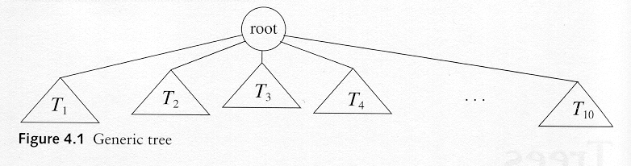
Trees
A tree is a collection of nodes
The collection can be empty
(recursive definition) If not empty, a tree consists of a distinguished node r (the root), and zero or more nonempty subtrees T₁, T₂, ...., T_{k}, each of whose roots are connected by a directed edge from r

Slide 4
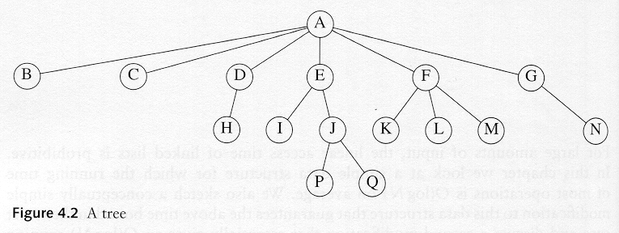
Some Terminologies
Child and Parent
Every node except the root has one parent
A node can have an zero or more children
Leaves
Leaves are nodes with no children
Sibling
nodes with same parent

Slide 5
More Terminologies
Path
A sequence of edges
Length of a path
number of edges on the path
Depth of a node
length of the unique path from the root to that node
Height of a node
length of the longest path from that node to a leaf
all leaves are at height 0
The height of a tree = the height of the root = the depth of the deepest leaf
Ancestor and descendant
If there is a path from n1 to n2
n1 is an ancestor of n2, n2 is a descendant of n1
Proper ancestor and proper descendant

Slide 6
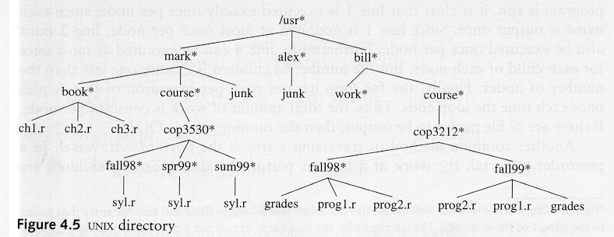
Example: UNIX Directory

Slide 7
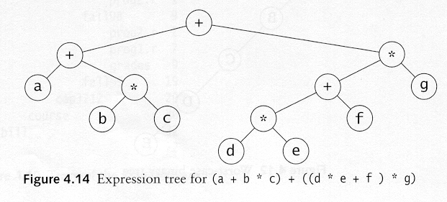
Example: Expression Trees
Leaves are operands (constants or variables)
The internal nodes contain operators
Will not be a binary tree if some operators are not binary

Slide 8
Tree Traversal
Used to print out the data in a tree in a certain order
Pre-order traversal
Print the data at the root
Recursively print out all data in the left subtree
Recursively print out all data in the right subtree

Slide 9
Preorder, Postorder and Inorder
Preorder traversal
node, left, right
prefix expression
++a*bc*+*defg

Slide 10
Preorder, Postorder and Inorder
Postorder traversal
left, right, node
postfix expression
abc*+de*f+g*+
Inorder traversal
left, node, right
infix expression
a+b*c+d*e+f*g

Slide 11
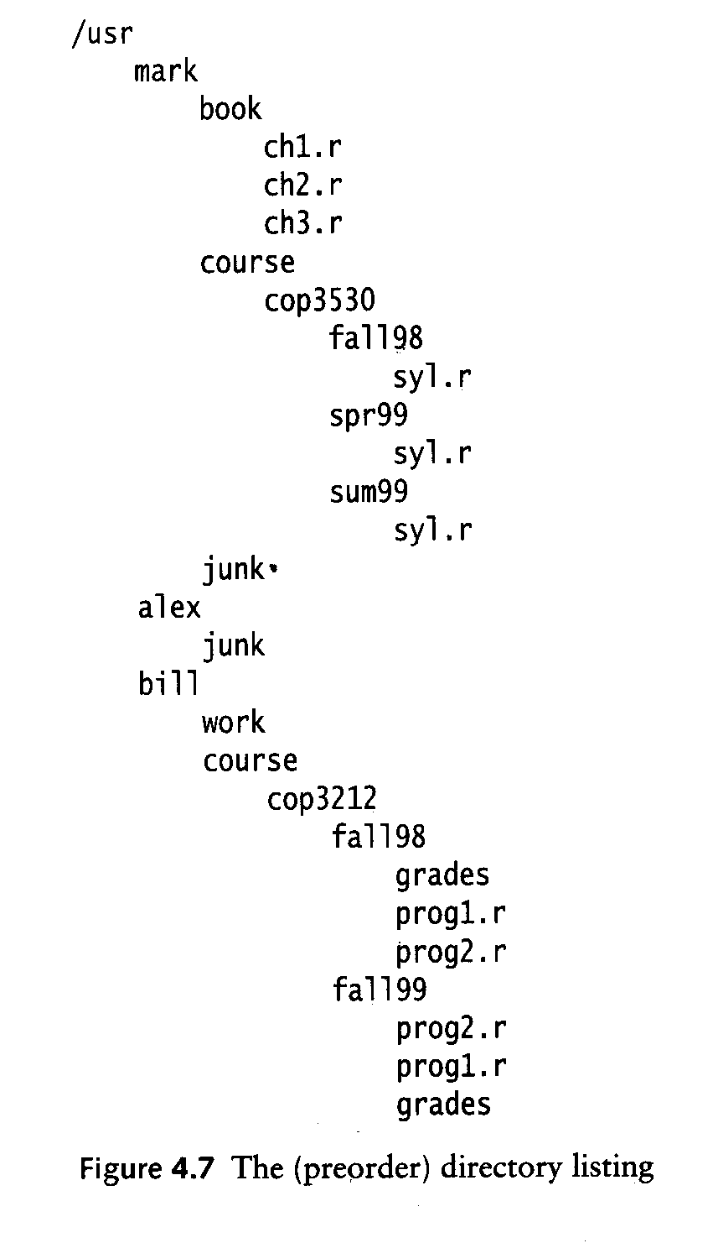
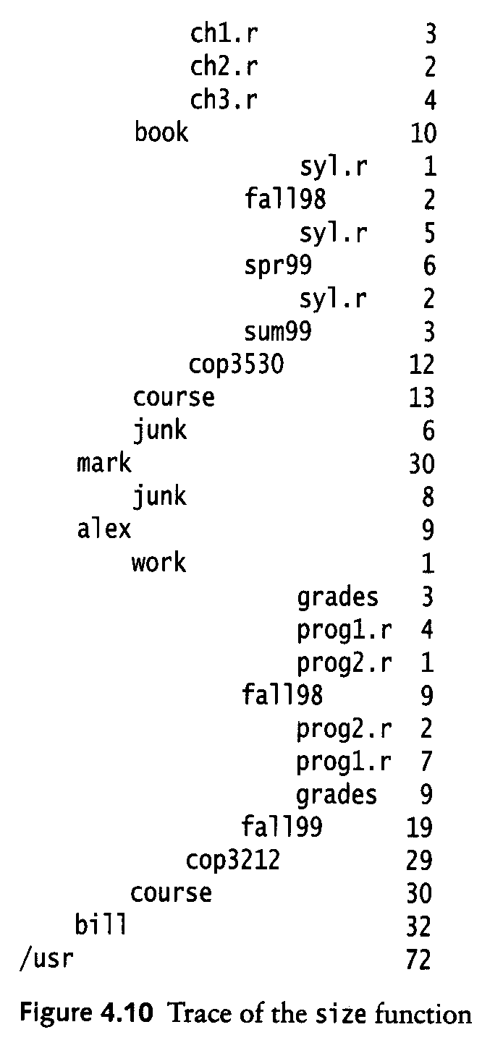
Example: Unix Directory Traversal
PreOrder
PostOrder

Slide 12
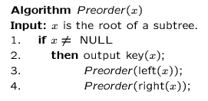
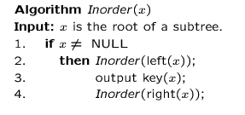
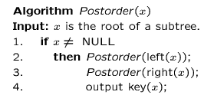
Preorder, Postorder and Inorder Pseudo Code

Slide 13
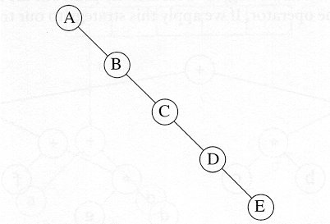
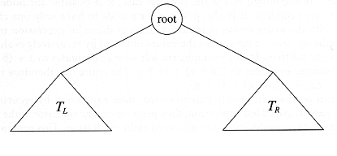
Binary Trees
A tree in which no node can have more than two children
The depth of an “average” binary tree is considerably smaller than N, even though in the worst case, the depth can be as large as N – 1.
Generic binary tree
Worst-case binary tree

Slide 14
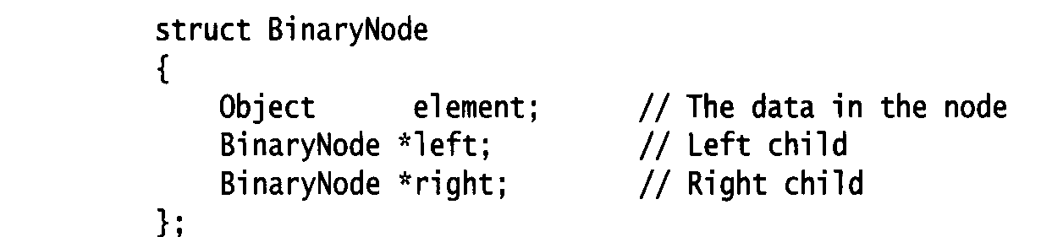
Node Struct of Binary Tree
Possible operations on the Binary Tree ADT
Parent, left_child, right_child, sibling, root, etc
Implementation
Because a binary tree has at most two children, we can keep direct pointers to them

Slide 15
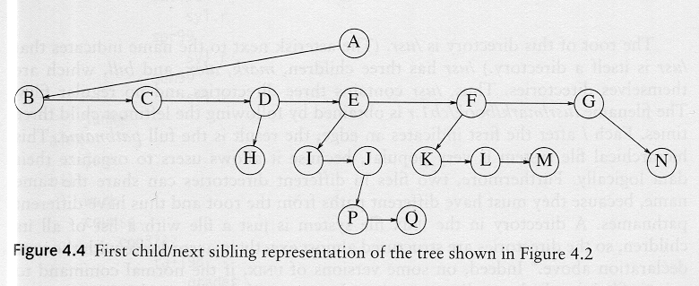
Convert a Generic Tree to a Binary Tree

Slide 16
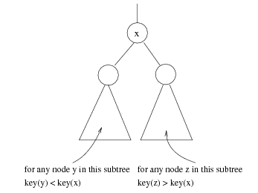
Binary Search Trees (BST)
A data structure for efficient searching, inser-tion and deletion
Binary search tree property
For every node X
All the keys in its left subtree are smaller than the key value in X
All the keys in its right subtree are larger than the key value in X

Slide 17
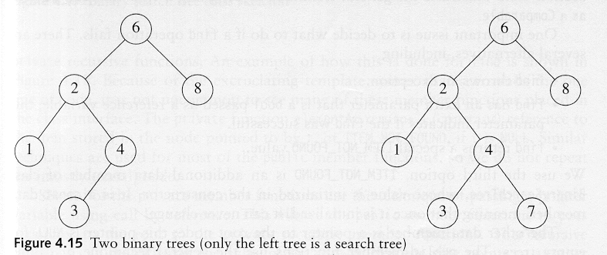
Binary Search Trees
A binary search tree
Not a binary search tree

Slide 18
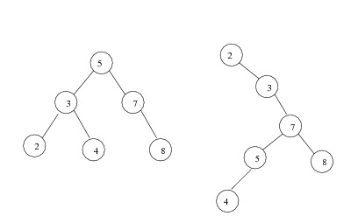
Binary Search Trees
The same set of keys may have different BSTs
Average depth of a node is O(log N)
Maximum depth of a node is O(N)

Slide 19
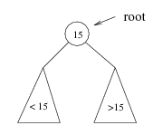
Searching BST
If we are searching for 15, then we are done.
If we are searching for a key < 15, then we should search in the left subtree.
If we are searching for a key > 15, then we should search in the right subtree.

Slide 20
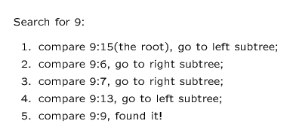
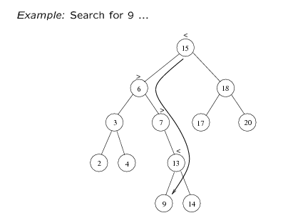

Slide 21
Searching (Find)
Find X: return a pointer to the node that has key X, or NULL if there is no such node
Time complexity: O(height of the tree)
BinaryNode * BinarySearchTree::Find(const float &x, BinaryNode *t) const
{
if (t == NULL)
return NULL;
else if (x < t->element)
return Find(x, t->left);
else if (t->element < x)
return Find(x, t->right);
else
return t; // match
}

Slide 22
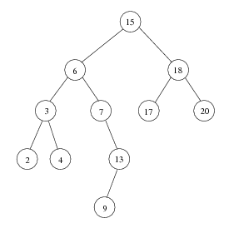
Inorder Traversal of BST
Inorder traversal of BST prints out all the keys in sorted order
Inorder: 2, 3, 4, 6, 7, 9, 13, 15, 17, 18, 20

Slide 23
findMin/ findMax
Goal: return the node containing the smallest (largest) key in the tree
Algorithm: Start at the root and go left (right) as long as there is a left (right) child. The stopping point is the smallest (largest) element
Time complexity = O(height of the tree)
BinaryNode * BinarySearchTree::FindMin(BinaryNode *t) const
{
if (t == NULL)
return NULL;
if (t->left == NULL)
return t;
return FindMin(t->left);
}

Slide 24
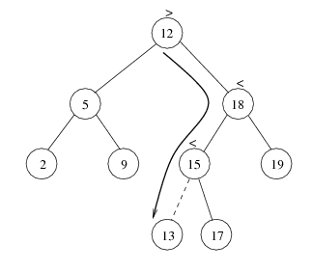
Insertion
Proceed down the tree as you would with a find
If X is found, do nothing (or update something)
Otherwise, insert X at the last spot on the path traversed
Time complexity = O(height of the tree)

Slide 25


Deletion
When we delete a node, we need to consider how we take care of the children of the deleted node.
This has to be done such that the property of the search tree is maintained.

Slide 26
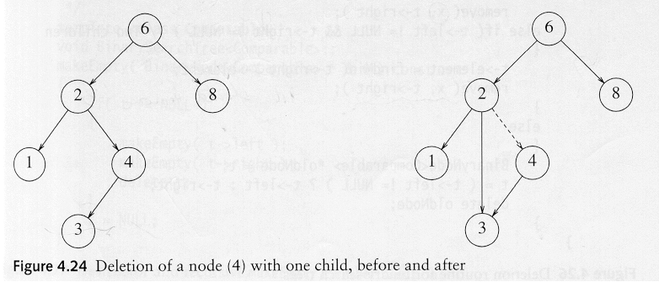
Deletion under Different Cases
Case 1: the node is a leaf
Delete it immediately
Case 2: the node has one child
Adjust a pointer from the parent to bypass that node

Slide 27
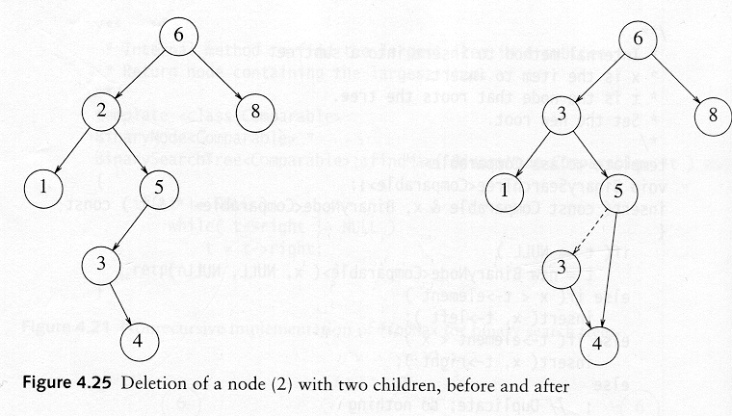
Deletion Case 3
Case 3: the node has 2 children
Replace the key of that node with the minimum element at the right subtree
Delete that minimum element
Has either no child or only right child because if it has a left child, that left child would be smaller and would have been chosen. So invoke case 1 or 2.
Time complexity = O(height of the tree)

